Slide 1

UNIT-III
Linked List

Slide 2
UNIT – II
Dynamic Linear Data Structure: Linked List, Characteristics of a Linked List,
Types of Linked List: Singly linked, doubly linked and circular. Applications of Linked List.
Implementation of stacks and queue using linked list.

Slide 3
The List ADT
A sequence of zero or more elements
A₁, A₂, A₃, … A_{N}
N: length of the list
A₁: first element
A_{N}: last element
A_{i}: position i
If N=0, then empty list
Linearly ordered
A_{i} precedes A_{i+1}
A_{i} follows A_{i-1}

Slide 4
Operations
printList: print the list
makeEmpty: create an empty list
find: locate the position of an object in a list
list: 34,12, 52, 16, 12
find(52) → 3
insert: insert an object to a list
insert(x,3) → 34, 12, 52, x, 16, 12
remove: delete an element from the list
remove(52) → 34, 12, x, 16, 12
findKth: retrieve the element at a certain position

Slide 5
Implementation of an ADT
Choose a data structure to represent the ADT
E.g. arrays, records, etc.
Each operation associated with the ADT is implemented by one or more subroutines
Two standard implementations for the list ADT
Array-based
Linked list

Slide 6
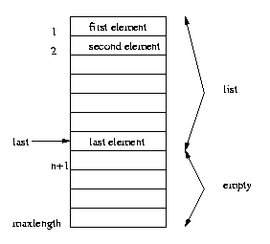
Array Implementation
Elements are stored in contiguous array positions

Slide 7
Array Implementation...
Requires an estimate of the maximum size of the list
waste space
printList and find: linear
findKth: constant
insert and delete: slow
e.g. insert at position 0 (making a new element)
requires first pushing the entire array down one spot to make room
e.g. delete at position 0
requires shifting all the elements in the list up one
On average, half of the lists needs to be moved for either operation

Slide 8
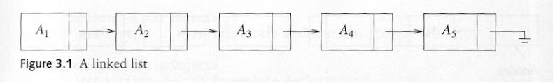
Pointer Implementation (Linked List)
Ensure that the list is not stored contiguously
use a linked list
a series of structures that are not necessarily adjacent in memory
Each node contains the element and a pointer to a structure containing its successor
the last cell’s next link points to NULL
Compared to the array implementation,
the pointer implementation uses only as much space as is needed for the elements currently on the list
but requires space for the pointers in each cell

Slide 9
Why use linked lists?
Linked list is often compared to arrays. Whereas an array is a fixed size of sequence, a linked list can have its elements to be dynamically allocated.
Advantages:
No wastage of memory: It only allocates the memory required for values to be stored or inserted because size of the linked list increase or decrease at run time. So, there is no need to pre-allocate the memory.
Implementation of stack and queue: Linear data structures like stack and queues are often easily implemented using a linked list.
Easy to insert and delete a node: Insertion and deletion node operations are easily implemented in a linked list.
Disadvantages:
Memory Usage: More memory is required to store elements in linked list as compared to array. Because in linked list each node contains a pointer and it requires extra memory for itself.
Linear look up time: When looking for a value in a linked list, you have to start from the beginning of chain, and check one element at a time for a value you’re looking for. For example, if we want to access a node at position n then we have to traverse all the nodes before it. So, time required to access a node is large.
Reverse Traversing: In linked list reverse traversing is really difficult. In case of doubly linked list its easier but extra memory is required for back pointer hence wastage of memory.

Slide 10
Linked Lists
A
B
C
∅
Head
A linked list is a series of connected nodes
Each node contains at least
A piece of data (any type)
Pointer to the next node in the list
Head: pointer to the first node
The last node points to NULL
node
A
data
pointer

Slide 11
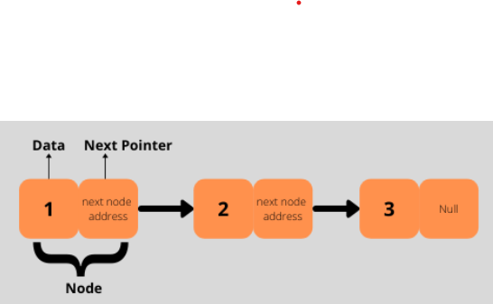
A Simple Linked List Class
We use two classes: Node and List
Declare Node class for the nodes
data: double-type data in this example
next: a pointer to the next node in the list

Slide 12
Creation of a Linked List
class Node:
# Creating a node
def __init__(self, item):
self.item = item
self.next = None
class LinkedList:
def __init__(self):
self.head = None
linked_list = LinkedList()
# Assign item values
linked_list.head = Node(1)
second = Node(2)
third = Node(3)
# Connect nodes
linked_list.head.next = second
second.next = third
# Print the linked list item
while linked_list.head != None:
print(linked_list.head.item, end=" ")
linked_list.head = linked_list.head.next

Slide 13

Linked List
Linked List properties:
Successive elements are connected by pointers
The last element points to NULL
Can grow or shrink in size during execution of a program
Can be made just as long as required (until systems memory exhausts)
Does not waste memory space (but takes some extra memory for pointers)

Slide 14
Linked List
Types of Linked Lists:
Basically we can put linked lists into the following four items:
1. Single Linked List.
2. Double Linked List.
3. Circular Linked List.
4. Circular Double Linked List.

Slide 15
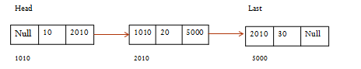
Linked List
Single Linked List.
Double Linked List.
myList
a
b
c
d

Slide 16
Linked List
Circular Single Linked List
head
last
1000
10
2010
20
1000
800
1000
2010
Circular double Linked List
Head
Last
2010 | 10 | 2010
1010 | 20 | 5000
2010 | 30 | 1010
1010
2010
5000

Slide 17
Single Linked List
Single Linked List:
The basic operations in a single linked list are:
• Creation.
• Insertion.
• Deletion.
• Traversing.

Slide 18
Single Linked List
#Node of a Singly Linked List
class Node:
#constructor
def __init__ (self):
self.data = None
self.next = None
#method for setting the data field of the node
def setData(self,data):
self.data = data
#method for getting the data field of the node
def getData(self):
return self.data
#method for setting the next field of the node
def setNext(self,next):
self. next = next
#method for getting the next field of the node
def getNext(self):
return self.next
#returns true if the node points to another node
def hasNext(self):
return self.next != None

Slide 19
Single Linked List
Insertion of a Node:
One of the most primitive operations that can be done in a singly linked list is the insertion of a node.
Memory is to be allocated for the new node (in a similar way that is done while creating a list) before reading the data.
The new node will contain empty data field and empty next field.
The data field of the new node is then stored with the information read from the user.
The next field of the new node is assigned to NULL.
The new node can then be inserted at three different places namely:
• Inserting a node at the beginning.
• Inserting a node at the end.
• Inserting a node at intermediate position.

Slide 20

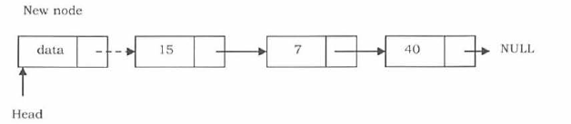
Single Linked List
Inserting a node at the beginning.
In this case, a new node is inserted before the current head node. Only one next pointer needs to be modified (new node's next pointer) and it can be done in two steps:
Step 1: Update the next pointer of new node, to point to the current head/start
Step 2: Update head pointer to point to the new node.

Slide 21
Single Linked List
Inserting a node at the beginning.
#method for inserting a new node at the beginning of the Linked List (at the head)
def insertAtBeginning(self,data):
newNode = Node()
newNode.setData(data)
if self.length == 0:
self.head= newNode
else:
newNode.setNext(self.head)
self.head = newNode
self.length += 1

Slide 22
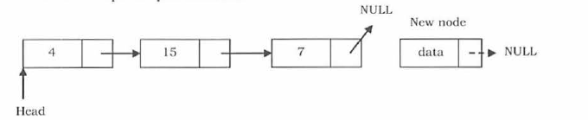
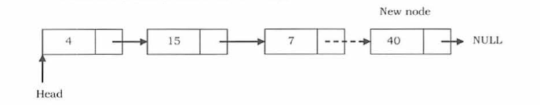
Single Linked List
Inserting a node at the end:
In this case, we need to modify two next pointers (last nodes next pointer and new nodes next pointer).
Step1: New nodes next pointer points to NULL .
Step2: Last nodes next pointer points to the new node .

Slide 23
Single Linked List
Inserting a node at the end:
#method for inserting a new node at the end of a Linked List
def insertAtEnd(self,data):
newNode= Node()
newNode.setData(data)
current= self.head
while current.getNext() != None:
current = current.getNext()
current.setNext(newNode)
self.length+= 1

Slide 24
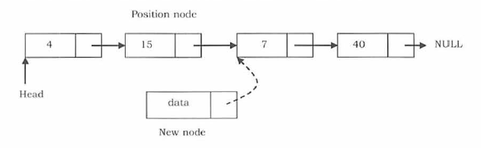
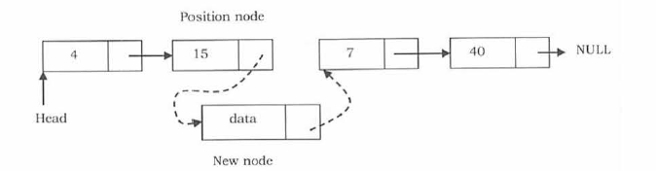
Single Linked List
Inserting a node into the single linked list at a specified intermediate position other than beginning and end.
Let us assume that we are given a position where we want to insert the new node. In this case also, we need to modify two next pointers.
If we want to add an element at position 3 then we stop at position 2. That means we traverse 2 nodes and insert the new node. For simplicity let us assume that the second node is called position node.
The new node points to the next node of the position where we want to add this node.
Position nodes next pointer now points to the new node.

Slide 25
Single Linked List
Inserting a node into the single linked list at a specified intermediate position other than beginning and end.
#Method for inserting a new node at any position in a Linked List
def insertAtPos(self,pos,data):
if pos > self.length or pos < 0:
return None
else:
if pos == 0:
self.insertAtBeg(data)
elif pos ==self.length :
self.insertAtEnd (data)
else:
newNode = Node()
newNode. setData(data)
count= 0
current= self.head
while count< pos-1:
count+= 1
current = current.getNext()
newNode.setNext(current.getNext())
current.setNext(newNode)
self.length += 1

Slide 26
Single Linked List
Traversal and displaying a list (Left to Right):
To display the information, you have to traverse (move) a linked list, node by node from the first node, until the end of the list is reached.
Let us assume that the head points to the first node or the list.
To traverse the list we do the following.
follow the pointers.
Display the contents of the nodes (or count) as they are traversed.
Stop when the next pointer points to NULL.

Slide 27
Single Linked List
Traversal and displaying a list (Left to Right):
The ListLength() function takes a linked list as input and counts the number of nodes in the list.
The function given below can be used for printing the list data with extra print function.
def listLength(self):
current= self.head
count= 0
while current != None:
count = count+ 1
current= current.getNext()
print(current.getData())
return count

Slide 28
Single Linked List
Deletion of a node:
Another primitive operation that can be done in a singly linked list is the deletion of a node. Memory is to be released for the node to be deleted. A node can be deleted from the list from three different places namely.
• Deleting a node at the beginning.
• Deleting a node at the end.
• Deleting a node at intermediate position.

Slide 29
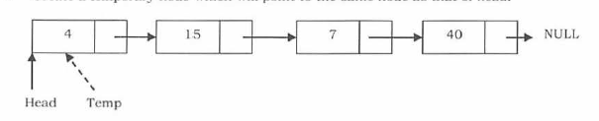
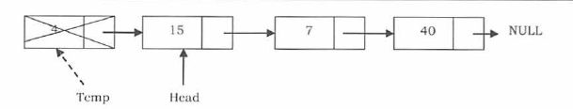
Single Linked List
Deletion of a node:
Deleting a node at the beginning:
First node (current head node) is removed from the list. It can be done in two steps:
• Create a temporary node which will point to the same node as that of head.
• Now, move the head nodes pointer to the next node and dispose of the temporary node.

Slide 30
Single Linked List
Deletion of a node:
Deleting a node at the beginning:
#method to delete the first node of the linked list
def deleteFromBeginning(self):
if self.length == 0:
print("The list is empty")
else:
print("deleted element is",self.head.getData())
self.head = self.head.getNext()
self.length -= 1

Slide 31
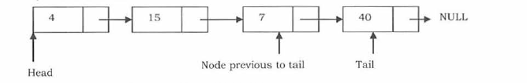
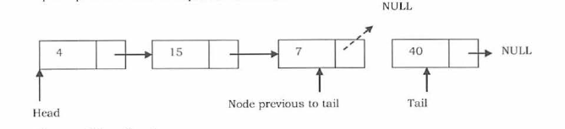
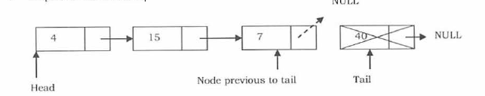
Single Linked List
Deleting a node at the end:
In this case, the last node is removed from the list. This operation is a bit trickier than removing the first node, because the algorithm should find a node, which is previous to the tail. It can be done in three steps:
• Traverse the list and while traversing maintain the previous node address also. By the time we reach the end of the list, we will have two pointers, one pointing to the tail node and the other pointing to the node before the tail node.
• Update previous nodes next pointer with NULL.
• Dispose of the tail node .

Slide 32
Single Linked List
Deleting a node at the end:
# Method to delete the last node of the linked list
def deleteLastNodeFromSinglyLinkedList(self):
if self.length == 0:
print ("The list is empty")
else:
currentnode = self.head
previousnode = self. head
while currentnode.getNext() != None:
previousnode = currentnode
currentnode = currentnode.getNext()
print("deleted element is",currentnode.getData())
previousnode.setNext(None)
self.length -= 1

Slide 33
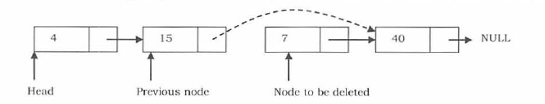
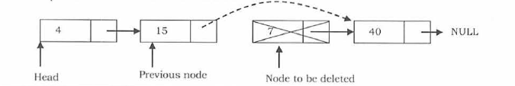
Single Linked List
Deleting a node at Intermediate position:
In this case, the node to be removed is always located between two nodes. Head and tail links are not updated in this case. Such a removal can be done in two steps:
• Similar to the previous case, maintain the previous node while traversing the list. Once we find the node to be deleted, change the previous node's next pointer to the next pointer of the node to be deleted.
• Dispose of the current node to be deleted .

Slide 34
Single Linked List
Deleting a node at Intermediate position:
#Method to delete a node at a particular position
def deleteAtPosition(self,pos):
count = 0
currentnode =self.head
previousnode = self. head
if pos > self.length or pos < 0:
print("The position does not exist. Please enter a valid position")
else:
while currentnode.next != None or count < pos:
count = count + 1
if count== pos:
if (count==1):
self.head=previousnode.next
print("deleted element is",currentnode.getData())

Slide 35
Single Linked List
Deleting a node at Intermediate position:
else:
previousnode.next = currentnode.next
print("deleted element is",currentnode.getData())
self.length -= 1
else:
previousnode = currentnode
currentnode = currentnode.next

Slide 36
Summary of all the programs related to singly linked list
Instead of defining the methods in Node class you can also define in Linked list class.

Slide 37
class Node:
def __init__(self, data):
self.data = data
self.next = None
class LinkedList:
def __init__(self):
self.head = None
def insert_at_end(self, data):
new_node = Node(data)
if self.head is None:
self.head = new_node
return
last_node = self.head
while last_node.next:
last_node = last_node.next
last_node.next = new_node
def insert_at_position(self, data, position):
new_node = Node(data)
if position == 0:
new_node.next = self.head
self.head = new_node
return
current_node = self.head
current_position = 0
while current_node and current_position < position - 1:
current_node = current_node.next
current_position += 1
if current_node is None:
print("Position out of range")
return
new_node.next = current_node.next
current_node.next = new_node

Slide 38
# Create a new linked list
my_list = LinkedList()
# Insert some nodes into the list
my_list.insert_at_end(1)
my_list.insert_at_end(2)
my_list.insert_at_end(3)
my_list.insert_at_beginning(0)
my_list.insert_at_position(4, 3)
# Print the contents of the list
my_list.print_list() # 0 1 2 4 3
def insert_at_beginning(self, data):
new_node = Node(data)
new_node.next = self.head
self.head = new_node
def print_list(self):
current_node = self.head
while current_node:
print(current_node.data, end=" ")
current_node = current_node.next
print()

Slide 39
An example of a linked list implementation in Python that stores a list of employees:
class Employee:
def __init__(self, name, emp_id, salary):
self.name = name
self.emp_id = emp_id
self.salary = salary
self.next = None
class EmployeeLinkedList:
def __init__(self):
self.head = None
def is_empty(self):
return self.head is None
def add_employee(self, name, emp_id, salary):
new_employee = Employee(name, emp_id, salary)
if self.is_empty():
self.head = new_employee
else:
current = self.head
while current.next is not None:
current = current.next
current.next = new_employee

Slide 40
def delete_employee(self, emp_id):
if self.is_empty():
return False
if self.head.emp_id == emp_id:
self.head = self.head.next
return True
current = self.head
while current.next is not None:
if current.next.emp_id == emp_id:
current.next = current.next.next
return True
current = current.next
return False

Slide 41
def get_employee(self, emp_id):
current = self.head
while current is not None:
if current.emp_id == emp_id:
return current
current = current.next
return None
def display(self):
current = self.head
while current is not None:
print(f"Name: {current.name}, ID: {current.emp_id}, Salary: {current.salary}")
current = current.next

Slide 42
employee_list = EmployeeLinkedList()
# Add some employees to the list
employee_list.add_employee("John", 1001, 50000)
employee_list.add_employee("Jane", 1002, 60000)
employee_list.add_employee("Bob", 1003, 70000)
# Display the list of employees
employee_list.display()
# Remove an employee from the list
employee_list.delete_employee(1002)
# Display the updated list of employees
employee_list.display()
# Retrieve an employee from the list
employee = employee_list.get_employee(1001)
if employee is not None:
print(f"Employee found: Name: {employee.name}, ID: {employee.emp_id}, Salary: {employee.salary}")
else:
print("Employee not found.")

Slide 43

www.mallareddyuniversity.ac.in
Notes:
You can safely remove this slide. This slide design was provided by SlideModel.com – You can download more templates, shapes and elements for PowerPoint from http://slidemodel.com

